Slide 1

LECTURE 11
I N T R O D U C T I O N T O R E A C T N AT I V E
DANIEL R YS JAN VÁCL AVÍK

Slide 2
O V E R V I E W
React
JSX
React Native
Compare React Native and Ionic
Installation
Props vs. state
Life cycles (initial, update)
Styles, Flexbox

Slide 3
R E A C T I N G E N E R A L

Slide 4
W H AT I S R E A C T
JS library for building UI
No MVC framework like Angular, Ember, etc.
Released 2013 by Facebook
Goes against some practices devs were used to

Slide 5

W H AT I S R E A C T
Only the View layer
JS library for building UI
No MVC framework like Angular, Ember, etc.
Released 2013 by Facebook
Goes against some practices devs were used to

Slide 6

W H AT I S R E A C T
Only the View layer
JS library for building UI
No MVC framework like Angular, Ember, etc.
Released 2013 by Facebook
Goes against some practices devs were used to
Template X Logic separation

Slide 7
R E A C T F E AT U R E S

Slide 8
C O M P O S A B L E C O M P O N E N T S
Building reusable components
Separation of concerns
Good for large apps

Slide 9
O N E - W AY D ATA B I N D I N G
Value can be updated only from the component itself
render() {
return <input value={this.state.value} onChange={this.handleChange} />
}
handleChange(e) {
this.setState({value: e.target.value});
}

Slide 10

V I R T U A L D O M
HTML diff which generates minimal necessary DOM change
Refreshes only changed elements
(No DOM in React Native)
http://bit.ly/1TjoJup

Slide 11
J S X
Briefer Javascript syntax extension looks like XML
Compiled to JS
Every HTML element is a “function” (component)
React doesn’t use HTML templates
Other frameworks include code into HTML, React includes “HTML” into the code

Slide 12
C O M P I L I N G J S X T O J S
var Nav;
// Input (JSX):
var app = <Nav color="blue" />;
// Output (JS):
var app = React.createElement(Nav, {color:"blue"});

Slide 13
M O R E C O M P L I C AT E D J S X I N R E A C T
1 <div>
2
<a onClick={() => this.showMovieDetail(movie)}>
<div>
<img src={"http://image.tmdb.org/t/p/ w500"+poster_path}/>
3
4
5 | <div>
6 | <span>{title}</span>
7 | <span>{vote_average} | / | 10</span>
8 | </div>
9 | </div>
10 | </a>
11 | <div style={styles.separator}/>
12 </div>

Slide 14
M O R E C O M P L I C AT E D J S X I N R E A C T N AT I V E
1 <View>
2
<TouchableHighlight onPress={() => this.showMovieDetail(movie)}>
<View>
<Image source={{uri: “http://image.tmdb.org/t/p/ w500"+poster_path}}/>
<View>
<Text>{title}</Text>
<Text>{vote_average} / 10</Text>
</View>
</View>
</TouchableHighlight>
3
4
5
6
7
8
9
10
<View style={styles.separator}/>
</View>

Slide 15

M O R E C O M P L I C AT E D J S X I N R E A C T N AT I V E
<div> -> <View>
1 <View>
2
<TouchableHighlight onPress={() => this.showMovieDetail(movie)}>
<View>
<Image source={{uri: “http://image.tmdb.org/t/p/ w500"+poster_path}}/>
<View>
<Text>{title}</Text>
<Text>{vote_average} / 10</Text>
</View>
</View>
</TouchableHighlight>
3
4
5
6
7
8
9
10
<View style={styles.separator}/>
</View>

Slide 16

M O R E C O M P L I C AT E D J S X I N R E A C T N AT I V E
<div> -> <View>
<img> -> <Image>
1 <View>
2
<TouchableHighlight onPress={() => this.showMovieDetail(movie)}>
<View>
<Image source={{uri: “http://image.tmdb.org/t/p/ w500"+poster_path}}/>
<View>
<Text>{title}</Text>
<Text>{vote_average} / 10</Text>
</View>
</View>
</TouchableHighlight>
3
4
5
6
7
8
9
10
<View style={styles.separator}/>
</View>

Slide 17

M O R E C O M P L I C AT E D J S X I N R E A C T N AT I V E
<div> -> <View>
<img> -> <Image>
1 <View>
2
<TouchableHighlight onPress={() => this.showMovieDetail(movie)}>
<View>
<Image source={{uri: “http://image.tmdb.org/t/p/ w500"+poster_path}}/>
<View>
<Text>{title}</Text>
<Text>{vote_average} / 10</Text>
</View>
</View>
</TouchableHighlight>
3
4
5
6
7
8
9
10
<View style={styles.separator}/>
</View>
Inline text -> <Text>

Slide 18
J S X : H T M L TA G S V S R E A C T C O M P O N E N T S
var myDivElement = <div className="foo" />; ReactDOM.render(myDivElement, document.getElementById('example'));

Slide 19
J S X : H T M L TA G S V S R E A C T C O M P O N E N T S
var myDivElement = <div className="foo" />; ReactDOM.render(myDivElement, document.getElementById('example'));
var MyComponent = React.createClass({/*...*/});
var myElement = <MyComponent someProperty={true} />; ReactDOM.render(myElement, document.getElementById('example'));

Slide 20
S E R V E R R E N D E R I N G
Code sharing
Better performance
SEO friendly

Slide 21
E V E R Y T H I N G I S A C O M P O N E N T

Slide 22
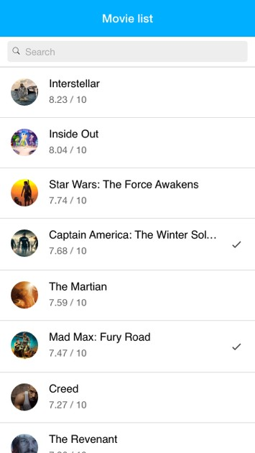
E V E R Y T H I N G I S A C O M P O N E N T

Slide 23
E V E R Y T H I N G I S A C O M P O N E N T
Search

Slide 24


E V E R Y T H I N G I S A C O M P O N E N T
Header
Search

Slide 25

E V E R Y T H I N G I S A C O M P O N E N T
Header
Search
Items

Slide 26

E V E R Y T H I N G I S A C O M P O N E N T
Header
Search
Items
Image

Slide 27

E V E R Y T H I N G I S A C O M P O N E N T
Header
Search
Items
Title
Image

Slide 28


E V E R Y T H I N G I S A C O M P O N E N T
Header
Search
Items
Title
Image
Rating

Slide 29

E V E R Y T H I N G I S A C O M P O N E N T
Header
Search
Items
Title
Image
WatchedMarker
Rating

Slide 30
W H AT I S R E A C T N AT I V E ?
Framework for building native mobile apps using React
Supports Android and iOS
(plan Windows universal platform in the future)
Based on Javascript and ReactJS

Slide 31

W H AT I S R E A C T N AT I V E ?
Framework for building native mobile apps using React
Supports Android and iOS
(plan Windows universal platform in the future)
Based on Javascript and ReactJS
EVERYBODY LOVES REACT!!!

Slide 32
W H Y R E A C T N AT I V E

Slide 33
S A M E S K I L L S E T O N E A C H P L AT F O R M
~70–80 % reuse of app code
Javascript (React)
Using “CSS” and “HTML” (looks like that)
One team can develop app for more platforms

Slide 34
J AVA S C R I P T W R A P S A R O U N D O B J E C T I V E - C / J AVA
We can add custom native components
Many native components for frequently used features (mainly for iOS)

Slide 35
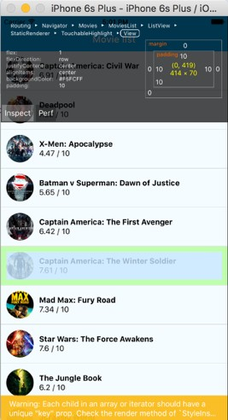
E A S Y T O D E B U G
Can use Chrome dev tools
Or Inspector in the app
Performance monitor

Slide 36

E A S Y T O D E B U G
Can use Chrome dev tools
Or Inspector in the app
Performance monitor

Slide 37
P R O D U C E S N AT I V E A P P S
Native feeling without additional work
Components are always up to date with current OS version

Slide 38
S T R O N G C O M M U N I T Y
32 242 stars on GitHub (May 2016)
Developed by Facebook
Many contributors

Slide 39
H O T R E L O A D
Updates code instantly during development
No page reload, modifying updated component only
Keep component state
Superb for styling the app

Slide 40

H O T R E L O A D
Updates code instantly during development
No page reload, modifying updated component only
Keep component state
Good bye waiting for Java compiling
Superb for styling the app

Slide 41
J AVA S C R I P T I N S E PA R AT E T H R E A D
React Native runs the JavaScript code in a separate thread
User interface does not block
Animations should be silky and smooth

Slide 42
D O W N S I D E S O F R E A C T N AT I V E
Lack of documentation, examples, tutorials
Poor Android support
Some components are missing (especially on Android)
Memory issues with PNG images on Android
Slower development than hybrid
Styling components from the scratch
Hard to identify problems during install and development (you will probably notice that)

Slide 43
D O W N S I D E S O F R E A C T N AT I V E
Lack of documentation, examples, tutorials
Poor Android support
Some components are missing (especially on Android)
Memory issues with PNG images on Android
Slower development than hybrid
Good luck Android devs
Styling components from the scratch
Hard to identify problems during install and development (you will probably notice that)

Slide 44
C O M PA R E R E A C T N AT I V E A N D I O N I C

Slide 45


React Native
Philosophy
Write once, run anywhere
Learn once, write anywhere
Mobile apps
Hybrid
Native
iOS, Android, WP10, mobile web, (desktop)
Platforms
iOS, Android
Ready to deploy
Yes
Not yet
Initial complexity
Low
High

Slide 46
I N S TA L L R E A C T N AT I V E
$ npm install -g react-native-cli
$ react-native init AwesomeProject

Slide 47
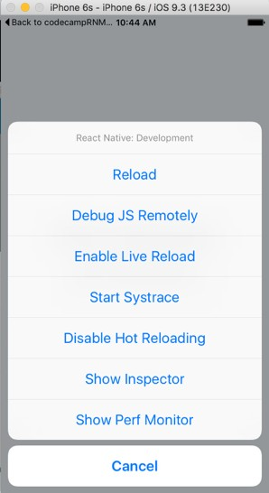
D E B U G G I N G
CMD + D: Development menu
CMD + R: Reload
Live reload, hot reload
Performance monitor

Slide 48

D E B U G G I N G
CMD + D: Development menu
CMD + R: Reload
Live reload, hot reload
Performance monitor

Slide 49
P R O P S V S . S TAT E

Slide 50
P R O P S V S . S TAT E
STATE: Local component state for storing data
PROPS: For reading data passed between components

Slide 51
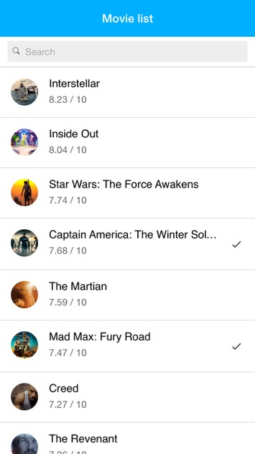
E X A M P L E – 2 C O M P O N E N T S

Slide 52
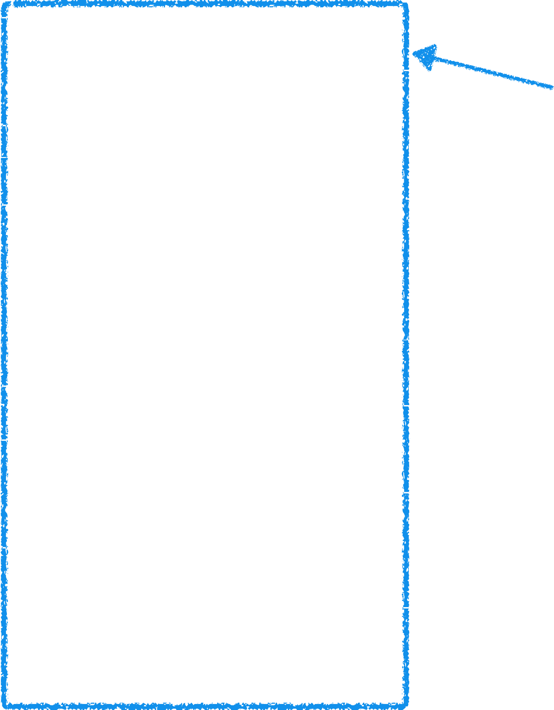
E X A M P L E – 2 C O M P O N E N T S
Movies (parent)

Slide 53
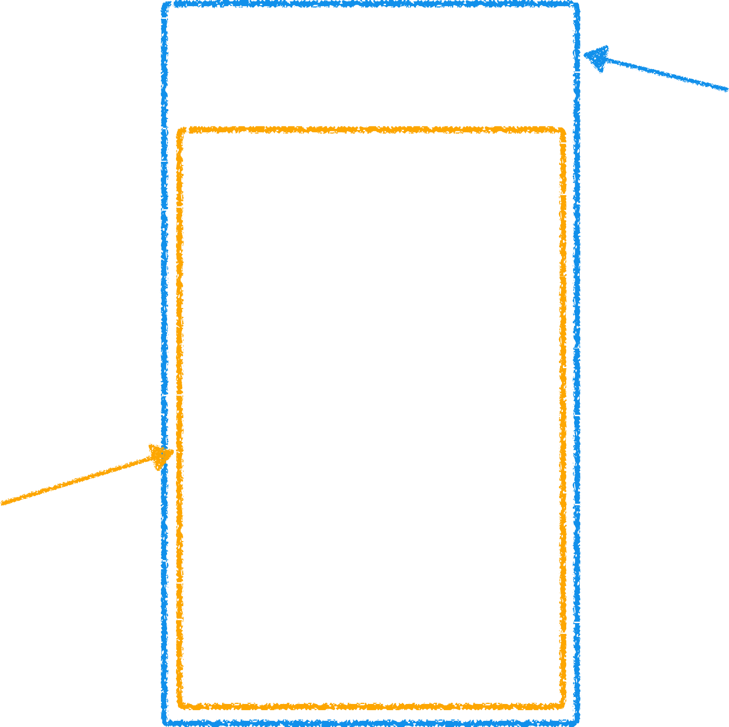
E X A M P L E – 2 C O M P O N E N T S
Movies (parent)
MovieList (child)

Slide 54
Component Movies (parent)
this.setState({
data: getDataFromApi()
})

Slide 55
Component Movies (parent)
this.setState({
data: getDataFromApi()
})
Component Movie List (child)
Receive SOME DATA for ListView

Slide 56
Component Movies (parent)
this.setState({
data: getDataFromApi()
})
<MovieList />
Component Movie List (child)
Receive SOME DATA for ListView

Slide 57

Component Movies (parent)
this.setState({
data: getDataFromApi()
})
Call component MovieList
<MovieList />
Component Movie List (child)
Receive SOME DATA for ListView

Slide 58
Component Movies (parent)
this.setState({
data: getDataFromApi()
})
<MovieList movies=“this.state.data” />
Component Movie List (child)
Receive SOME DATA for ListView

Slide 59

Component Movies (parent)
this.setState({
data: getDataFromApi()
})
Pass data to
MovieList component
movies=“this.state.data” />
<MovieList
Component Movie List (child)
Receive SOME DATA for ListView

Slide 60

Component Movies (parent)
this.setState({
data: getDataFromApi()
})
<MovieList movies=“this.state.data” />
Component Movies List (child)
Receive this.props.movies for ListView

Slide 61

Component Movies (parent)
this.setState({
data: getDataFromApi()
})
When state is changed, render function is called

Slide 62
L I F E C Y C L E

Slide 63
Component instantiated (initial)
getDefaultProps()
getInitialState()
componentWillMount()
render()
componentDidMount()

Slide 64
Component instantiated (initial)
Props changed (update)
setState() (update)
getDefaultProps()
componentWillReceiveProps()
getInitialState()
shouldComponentUpdate()
componentWillMount()
componentWillUpdate()
render()
componentDidMount()
componentDidUpdate()

Slide 65
Component instantiated (initial)
Props changed (update)
setState() (update)
Component deleted
getDefaultProps()
componentWillReceiveProps()
getInitialState()
shouldComponentUpdate()
componentWillMount()
componentWillUpdate()
componentWillUnmount()
render()
componentDidMount()
componentDidUpdate()

Slide 66
I N I T I A L L I F E C Y C L E

Slide 67
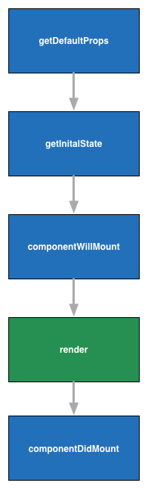

I N I T I A L L I F E C Y C L E
For defining default props which can be accessed via this.props

Slide 68

I N I T I A L L I F E C Y C L E
For defining default props which can be accessed via this.props
Interface between 2 components, remember?

Slide 69

I N I T I A L L I F E C Y C L E
For defining initial state which can be accessed via this.state

Slide 70
I N I T I A L L I F E C Y C L E
For defining initial state which can be accessed via this.state
Internal state only accessible by component

Slide 71
I N I T I A L L I F E C Y C L E
Called before render. Any state changes will not cause render

Slide 72
I N I T I A L L I F E C Y C L E
Returns React element with logic

Slide 73

I N I T I A L L I F E C Y C L E
Can access DOM (component tree) and every interaction with DOM should be done here (not in render)

Slide 74
U P D AT E L I F E C Y C L E

Slide 75
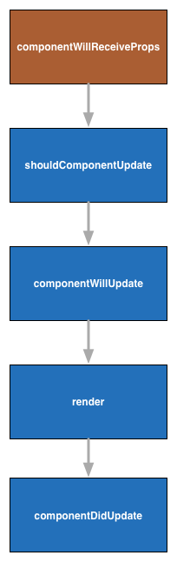
U P D AT E L I F E C Y C L E
Call only if props has changed. State can be changed without re- render

Slide 76
U P D AT E L I F E C Y C L E
Decide if component should be re-rendered. Returns true/false.
Has access to current and new state and props

Slide 77
U P D AT E L I F E C Y C L E
Call if shouldComponentUpdate returns true

Slide 78
U P D AT E L I F E C Y C L E
Returns React element with logic

Slide 79
U P D AT E L I F E C Y C L E
Can access DOM (component tree) and every interaction with DOM should be done here (not in render)

Slide 80
R E G I S T E R I N G C O M P O N E N T
import React, { Component } from 'react';
import { AppRegistry, Text,
View
} from 'react-native';
class Movies extends Component { render() {
return (
<View>
<Text>Hello</Text>
</View>
);
}
}
AppRegistry.registerComponent('Movies', () => Movies);

Slide 81

R E G I S T E R I N G C O M P O N E N T
import React, { Component } from 'react';
import { AppRegistry, Text,
View
} from 'react-native';
Dependency injection
class Movies extends Component { render() {
return (
<View>
<Text>Hello</Text>
</View>
);
}
}
AppRegistry.registerComponent('Movies', () => Movies);

Slide 82


R E G I S T E R I N G C O M P O N E N T
import React, { Component } from 'react';
import { AppRegistry, Text,
View
} from 'react-native';
Dependency injection
class Movies extends Component { render() {
return (
<View>
<Text>Hello</Text>
</View>
);
}
}
AppRegistry.registerComponent('Movies', () => Movies);
Register component

Slide 83
E V E N T S
FORM: onChange, onSubmit,…
MOUSE: onClick, onDoubleClick, onDrag, onDrop,…
KEYBOARD: onKeyPress,…
https://facebook.github.io/react/docs/events.html

Slide 84
E V E N T S F O R M
var MovieAdd = React.createClass({ render: function() {
return (
<form onSubmit={this._handleSubmit}>
<input ref="title" />
</form>
);
},
_handleSubmit: function(e) { console.log(this.refs.title)
}
});

Slide 85
C O M P O N E N T
Every component needs function render
Render function have to return JSX (or boolean)
Components should be reusable and independent

Slide 86
S T Y L E S H E E T S
No CSS in React, but similar attributes
Styles declared in JS
Should be outside of render function – no re-creating in every render
https://facebook.github.io/react-native/docs/style.html

Slide 87
S T Y L E S H E E T S I M P O R T
import React, { Component } from 'react';
import { AppRegistry, StyleSheet, Text,
View
} from 'react-native';

Slide 88
S T Y L E S H E E T S E X A M P L E
<Text style={styles.title}>Hello clippy</Text>
var styles = StyleSheet.create({ title: {
padding: 10,
fontSize: 15,
color: '#656565'
},
});

Slide 89

S T Y L E S H E E T S E X A M P L E
<Text style={styles.title}>Hello clippy</Text>
var styles = StyleSheet.create({ title: {
padding: 10,
fontSize: 15,
color: '#656565'
},
});

Slide 90
F L E X B O X
CSS layout type
Similar use as in CSS, different implementation
Used in React Native
http://bit.ly/1TjoJup
https://css-tricks.com/snippets/css/a-guide-to-flexbox/
90/95

Slide 91
F L E X B O X C O L U M N E X A M P L E
1 class HelloWorldView extends React.Component {
2
3
4
5
6
7
8
9
10
11 }
render() {
return (
<View style={{flexDirection: 'column', flex: 1}}>
<View style={{flex: 1, backgroundColor: 'red'}}></View>
<View style={{flex: 1, backgroundColor: 'green'}}></View>
<View style={{flex: 1, backgroundColor: 'blue'}}></View>
</View>
)
}

Slide 92
F L E X B O X R O W E X A M P L E
1 class HelloWorldView extends React.Component {
2
3
4
5
6
7
8
9
10
11 }
render() {
return (
<View style={{flexDirection: 'row', flex: 1}}>
<View style={{flex: 1, backgroundColor: 'red'}}></View>
<View style={{flex: 1, backgroundColor: 'green'}}></View>
<View style={{flex: 1, backgroundColor: 'blue'}}></View>
</View>
)
}

Slide 93
F L E X B O X R O W E X A M P L E
1 class HelloWorldView extends React.Component {
2
3
4
5
6
7
8
9
10
11 }
render() {
return (
<View style={{flexDirection: 'row', flex: 1}}>
<View style={{flex: 1, backgroundColor: 'red'}}></View>
<View style={{flex: 4, backgroundColor: 'green'}}></View>
<View style={{flex: 1, backgroundColor: 'blue'}}></View>
</View>
)
}

Slide 94
Q U E S T I O N S ?

Slide 95
JAN VÁCL AVÍK
@janvaclavik
DANIEL R YS
@danielrys
WW W.USER TECHNOLOGIES.COM

